Slide 1

EventBUZZ
Kajal Mittal (02135304418)
Sakshi Jain (03835304418)
Narayani (35135304418)

Slide 2
INTRODUCTION
This software leads in finding the college fests/events in easy way. This software of event scheduling helps student in finding all college event’s at one place. The system manages all the events which are conducted in College/University along with features: - add event, event cancellation and event registration. The need for going to various websites for the event schedule is overcome here.

Slide 3
PROBLEM STATEMENT
The Event-Buzz is software that is used by the event manager of various colleges to manage their college events. Students will access the software to get details of various events and to register themselves for these events. Admin will access the software to get details of various college events and delete the previously held events. It should be designed to provide functionalities as explained

Slide 4
OBJECTIVE
This project performs the task of developing a desktop based application that enables the students and faculty to retrieve the data very easily.
The main objective of developing “Event-Buzz” is to provide online information of various fests and events which are organized by various colleges.
This software application manages student details and registration along with their college names.
This is an internet based application that can be accessed throughout the campus.
This system can be useful to search the events, event registrations. The features are like login, add event, event cancellation, and report generation etc. in the system.

Slide 5
PROPOSED SYSTEM
The proposed system is a platform for the users to view the information about the events that took place in the past and the ones which are about to take place in the near future.
The purpose of making this application is to provide an easiness of finding the event schedule at one place.
The user will find the event schedule in one application rather to visit different web pages.
Participants can register for any happening event from anywhere.
Event manager can keep records of participants.

Slide 6
FEATURES AND FUNCTIONS
LOGIN: For security reasons all the users of the system are given unique user name and password.
CONTROL EVENT REGISTRATIONS: System will allow student to fill the college’s event registration form online.
ORGANISE EVENTS: System will allow event manager to add events for which the student does registrations.
VIEW EVENTS: System will allow student, event manager and admin to view report of uploaded events.
MANAGE PROFILE: System will allow students and event managers to update their account information.

Slide 7
TECHNICAL SKILLS USED
This ‘Event-Buzz’ application is a java based web-application that consists of interactive and menu-based interface.
Files are stored on the disk in the form of Java and JSP files.
To generate these files we may use Java, JSP, JDBC.

Slide 8
METHODOLOGIES USED
Apache Tomcat is used as the application server for the .jsp extension files. Java Server Pages (JSP) is a technology that helps software developers create dynamically generated web pages based on HTML, XML, or other document types. It uses Java programming language.
MySQL is used for database handling since MySQL is an open-source relational database management system.
JDBC API will be used for database connectivity with MySQL.
Eclipse Oxygen.3 is used as the IDE for developing the web application.

Slide 9
PLATFORM USED
Software’s Used:
Eclipse Oxygen 3 IDE
Tomcat Apache Server
Browser:- Chrome
Hardware’s Used:
RAM : 4GB
Hard Disk : 512 GB
Processor : Intel Core i3

Slide 10
BASIC SYSTEM REQUIREMENTS
To achieve the objective of the project, some requirements were specified. The requirements tell about what the application should cover and what it will not cover. It defines the scope of the project as follows:-
This web-application can be run on both Windows and Mac operating systems with a minimum hardware and software requirements through an appropriate browser only.

Slide 11
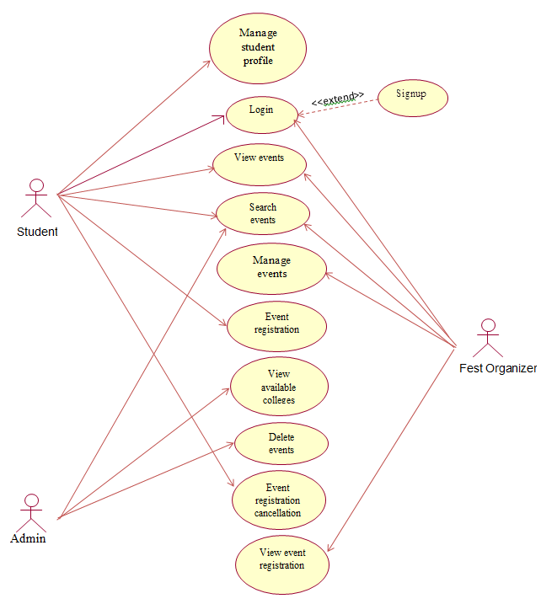
USE-CASE DIAGRAM

Slide 12
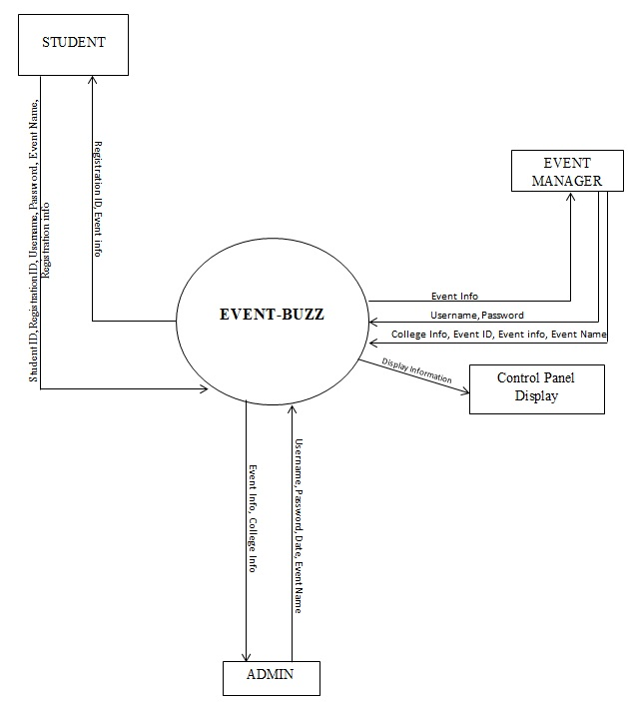
Data Flow Diagram (LEVEL-0)

Slide 13
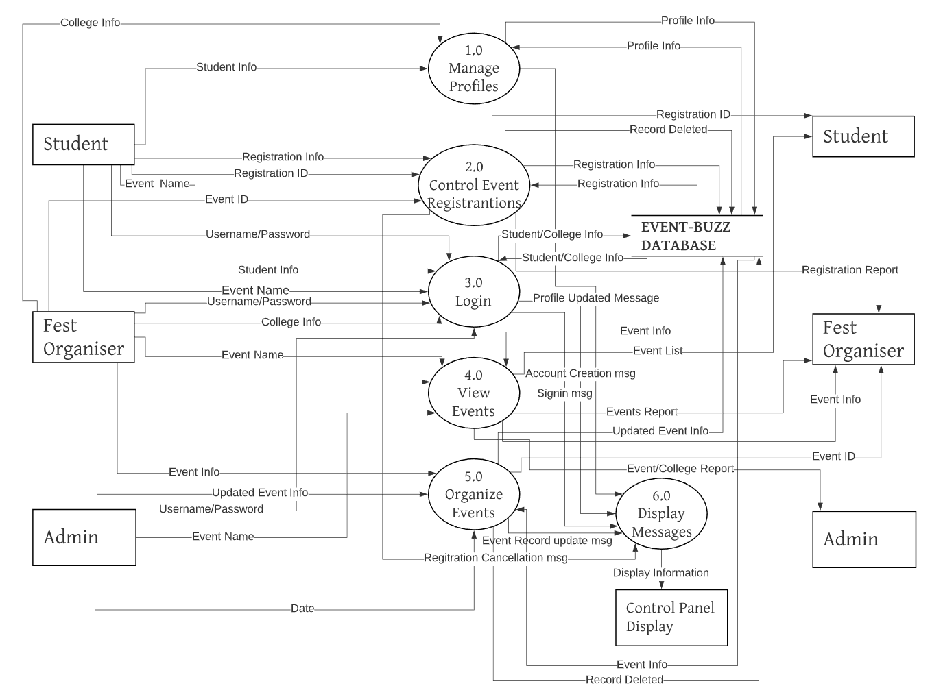
Data Flow Diagram (LEVEL-1)

Slide 14
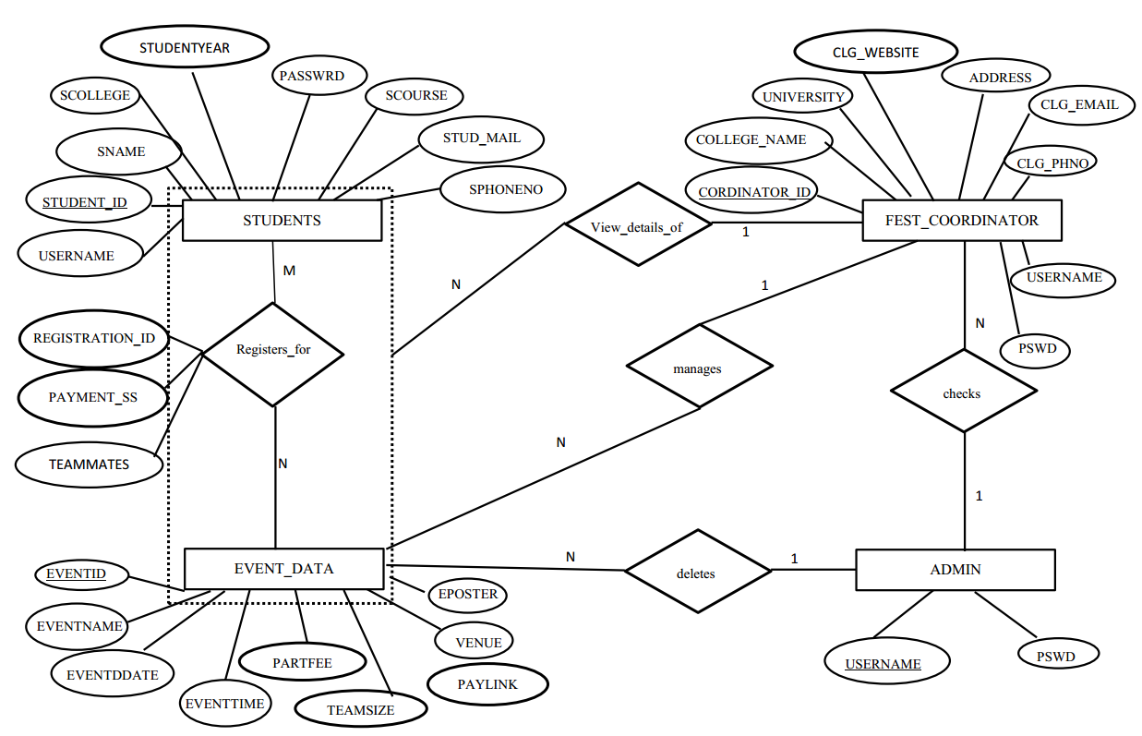
Entity Relationship Diagram

Slide 15
ADVANTAGES
It manages the large amount of data.
Reduces paper work
Time saving activity
Reduces man power thereby reduces cost
Avoids risk of loss and missing documents
Makes data easy to share
High security control
Easily manage the records.

Slide 16
FUTURE SCOPE AND ENHANCEMENTS
Various filters can be introduced for easier sorting and searching of the data.
Payment Gateway can be included further to pay the registration fees directly from this application.
Cart feature can be introduced to shortlist the interested events easily by students.

Slide 17
SCREENSHOTS

Slide 18
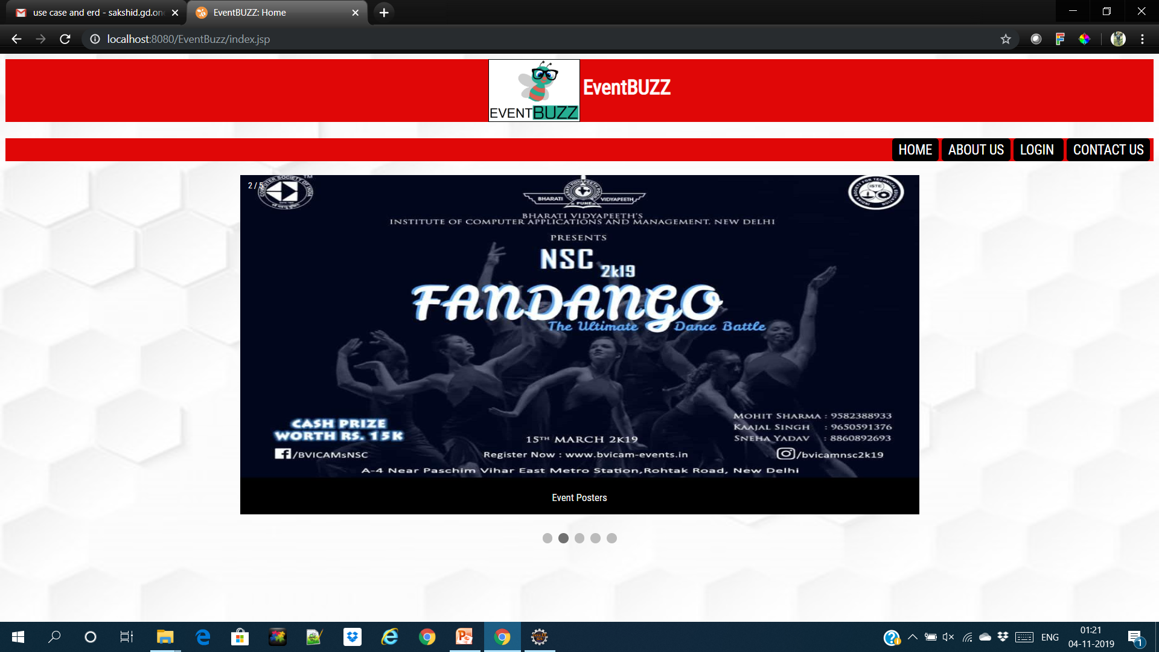

Slide 19
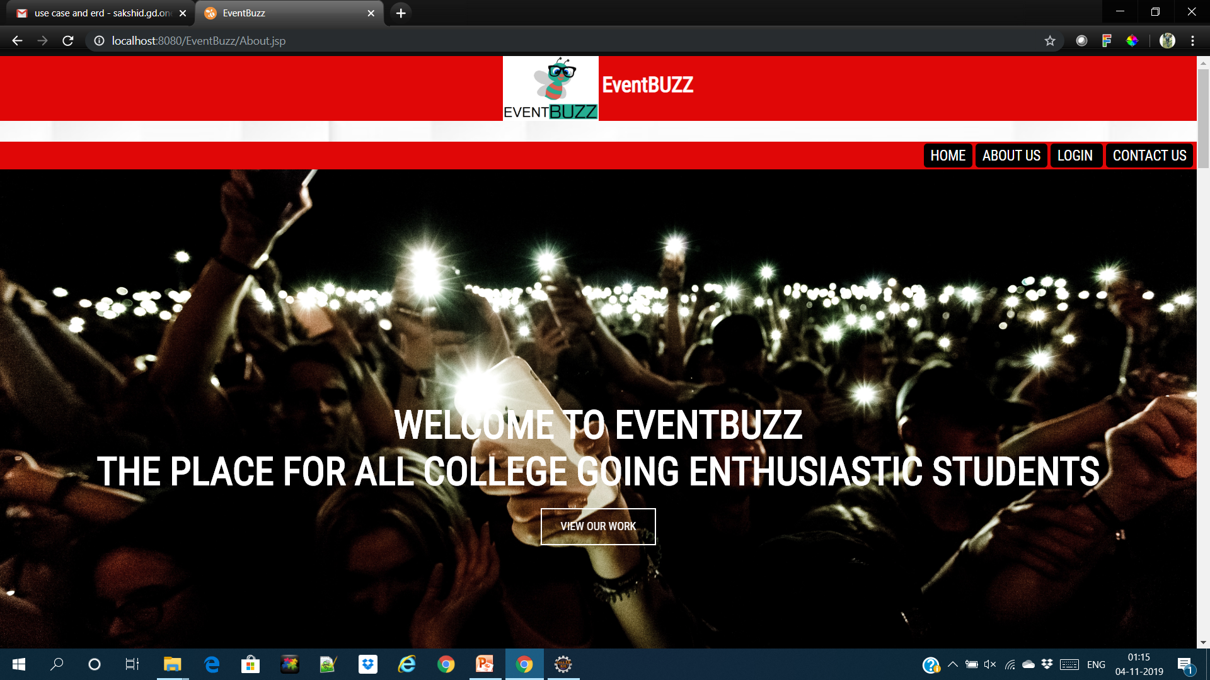

Slide 20
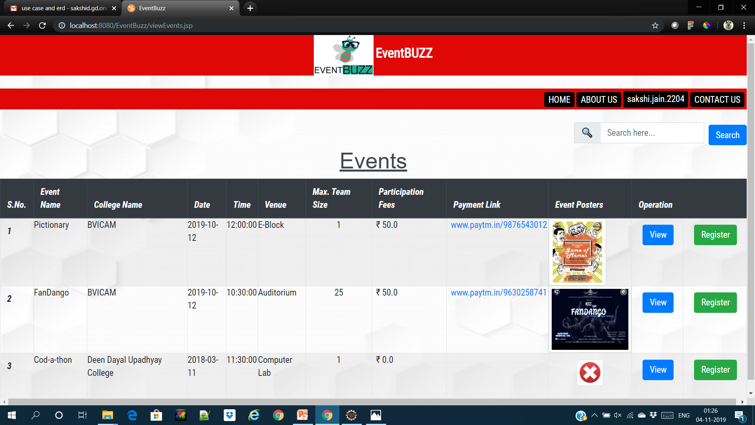

Slide 21
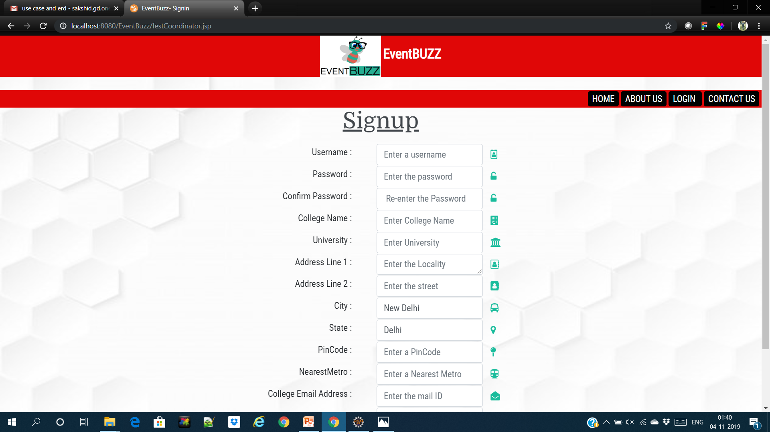

Slide 22
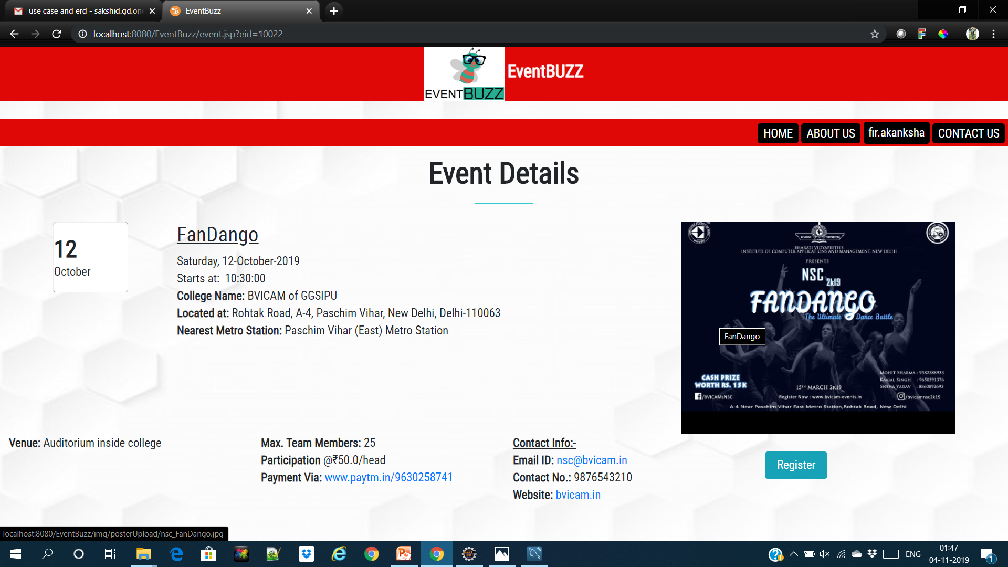

Slide 23
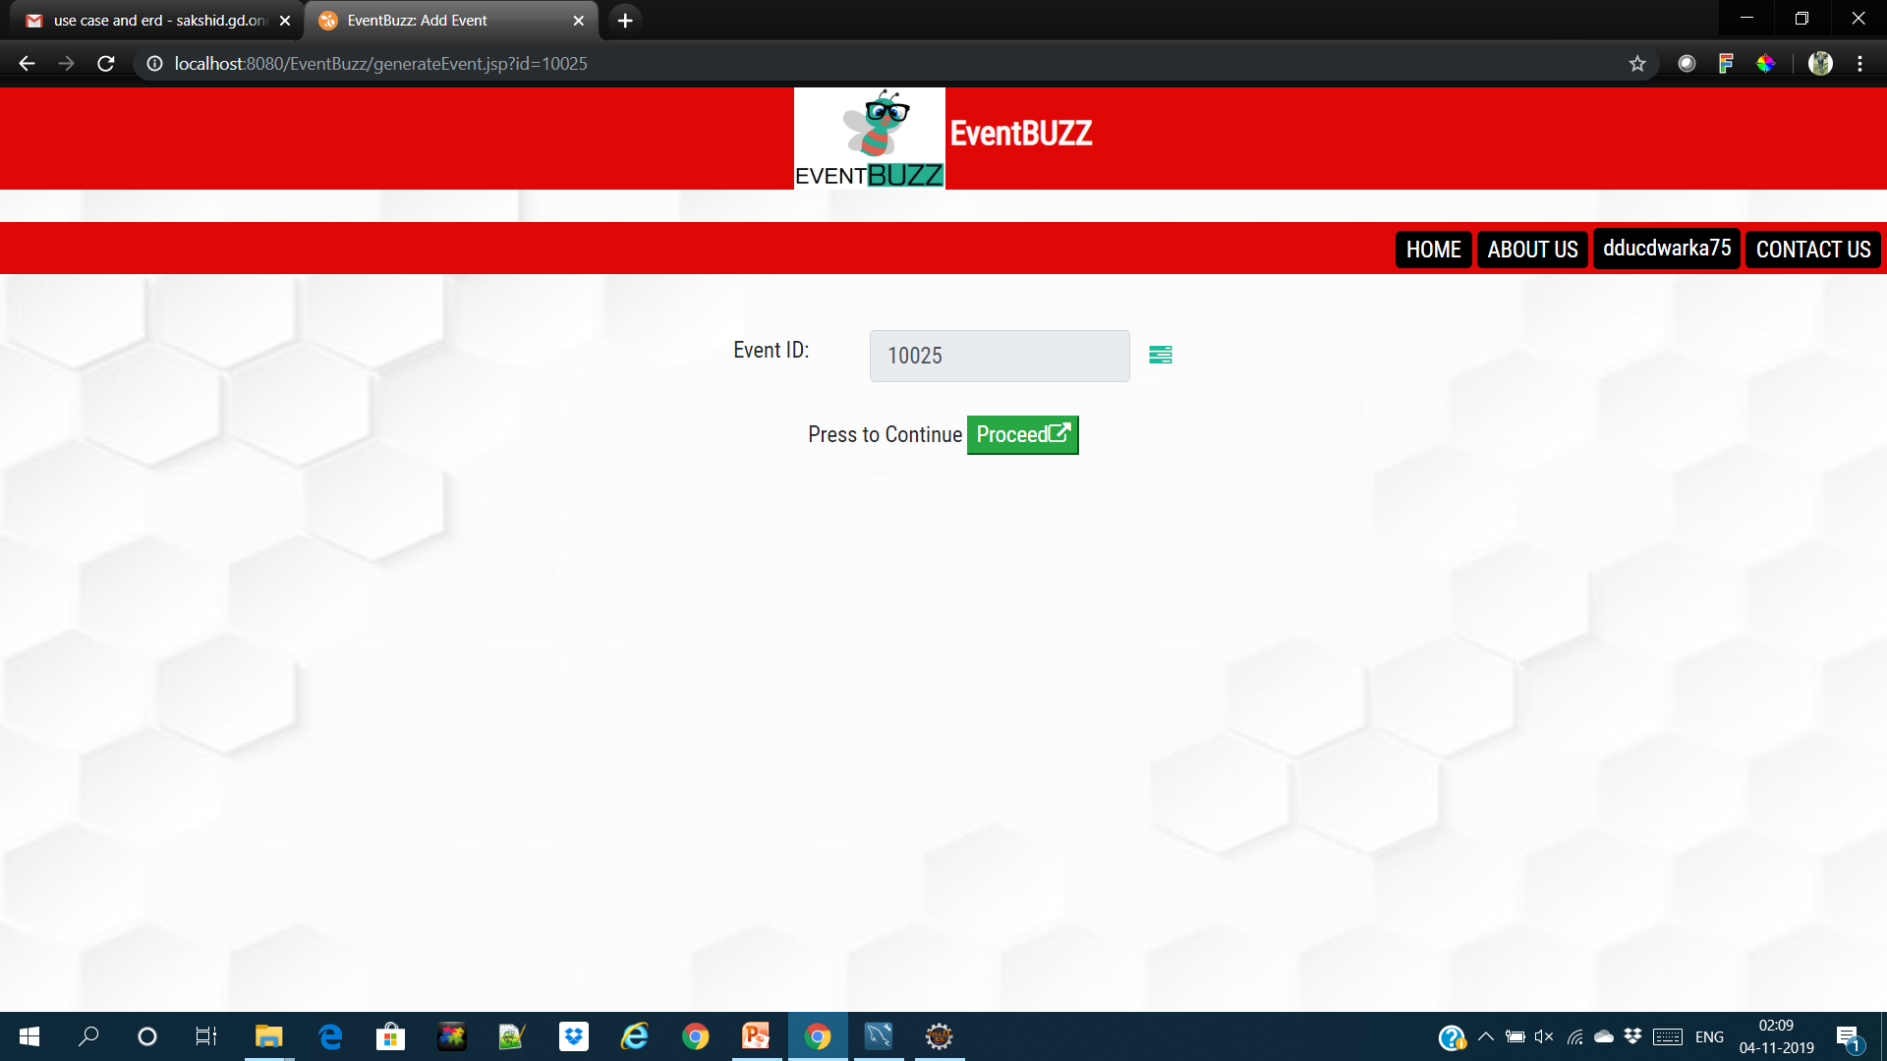

Slide 24
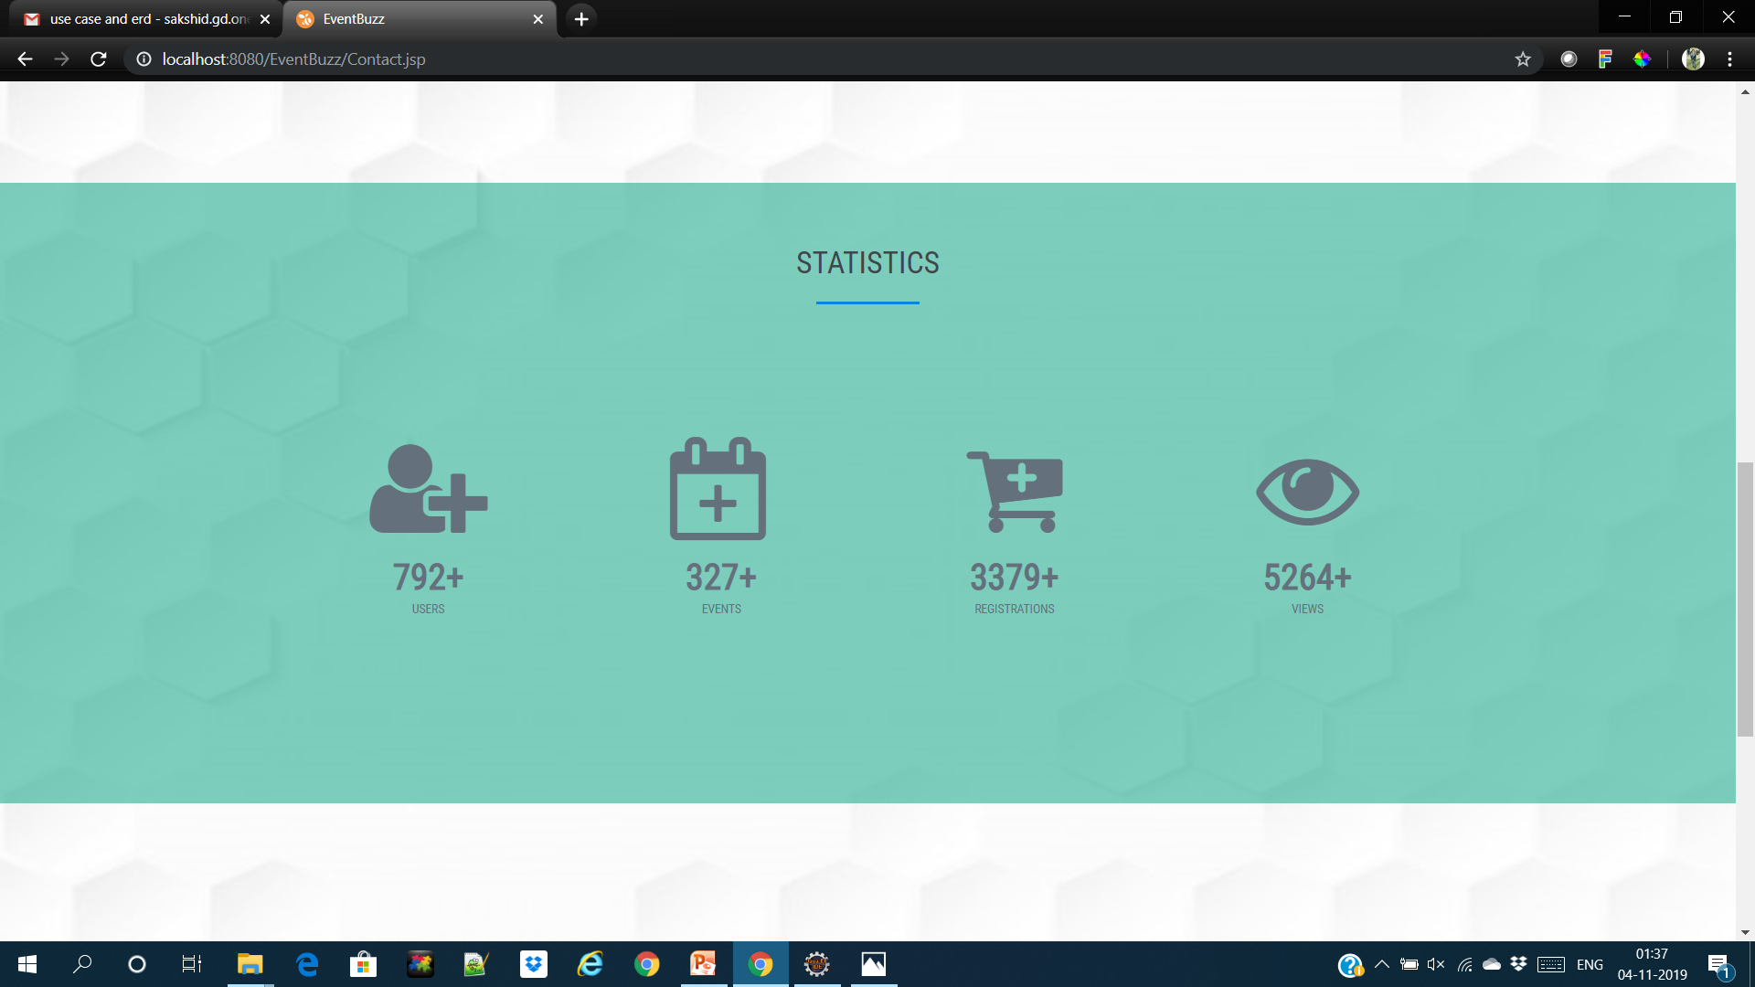

Slide 25
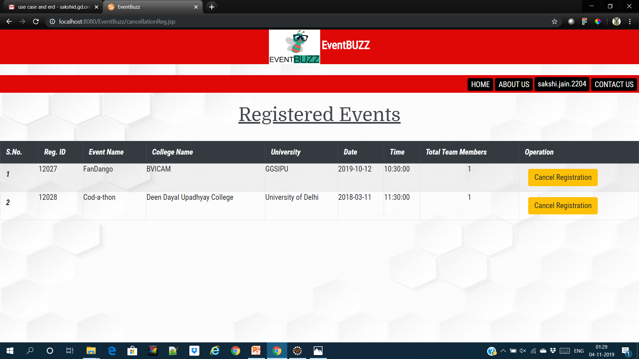

Slide 26
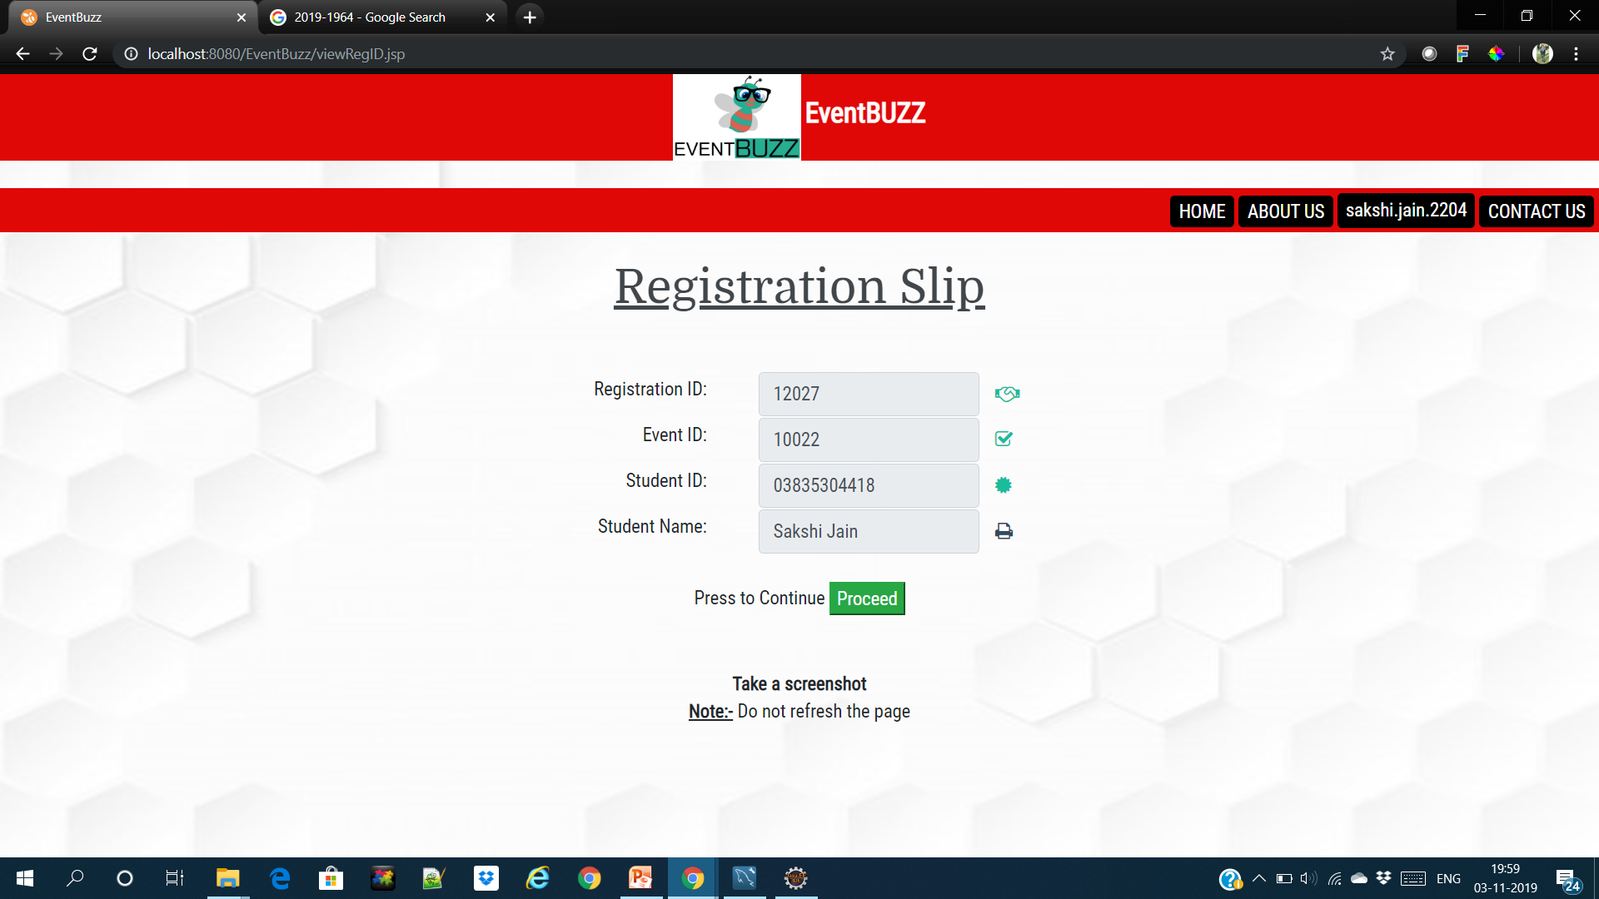

Slide 27
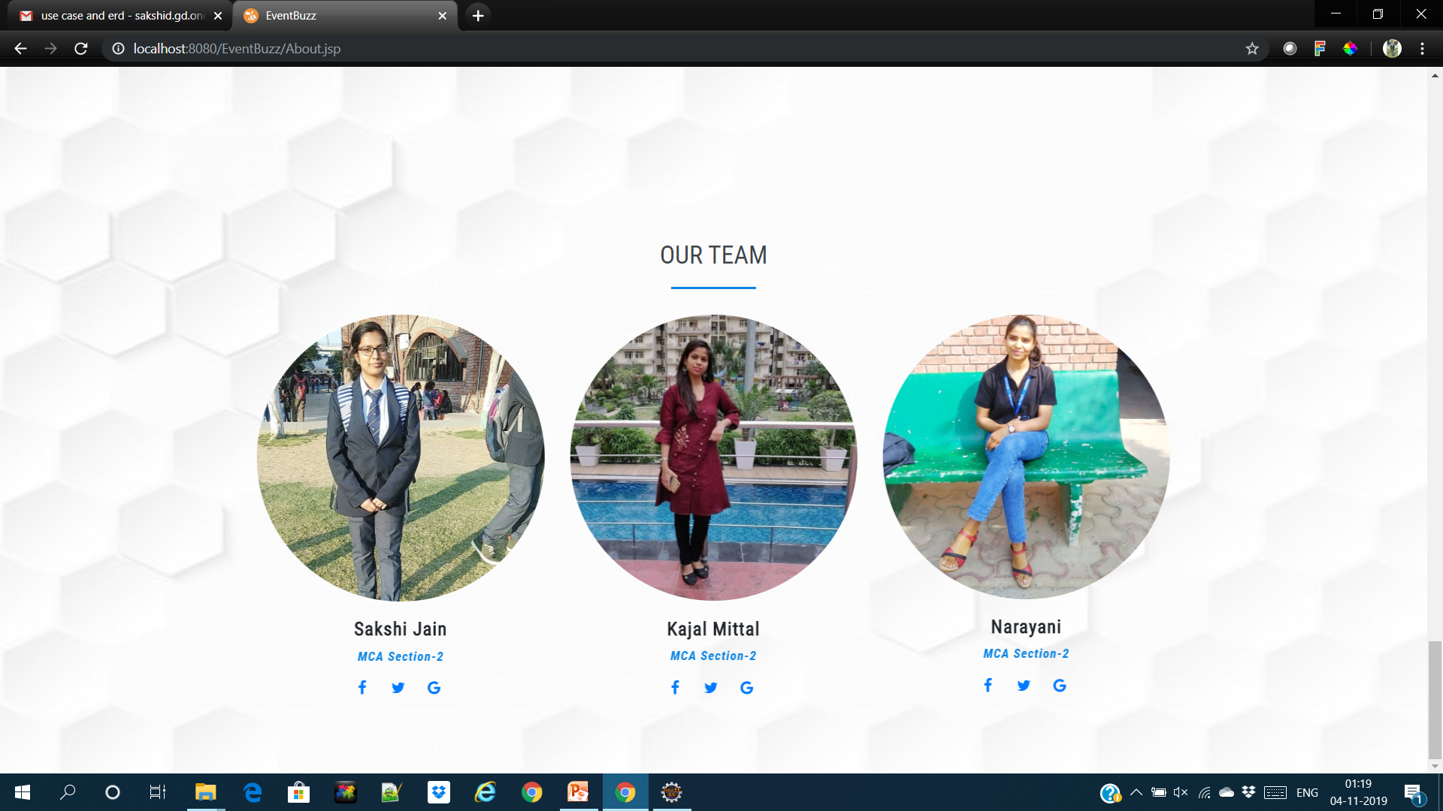

Slide 28
THANK YOU….

